Slide 1
Linear Regression

Slide 2
Key concept
In the first part of this section we find the equation of the straight line that best fits the paired sample data. That equation algebraically describes the relationship between two variables.
The best-fitting straight line is called a regression line and its equation is called the regression equation.

Slide 3
Simple linear regression
Regression Equation – given a collection of paired sample data, the regression equation that algebraically describes the relationship between the two variables 𝑥 and 𝑦 is 𝑦 =𝑏₀+𝑏₁𝑥
The regression equation attempts to describe a relationship between two variables
Inherently, the equation algebraically describes how the values of one variable are somehow associated with the values of the other variable
Regression line – the graph of the regression equation
Also known as the “line of best fit” or the “least square line”
The regression line fits the sample points best

Slide 4
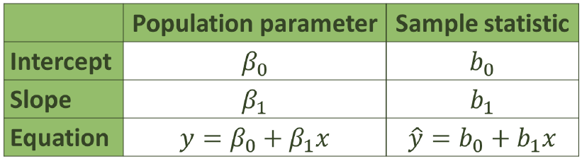
notation
Notice the 𝑦 in the sample regression equation!
This implies that we are predicting something!
We are predicting values for 𝑦 based upon true and observed values of 𝑥.

Slide 5
Requirements for simple linear regression
1.The sample of paired data is a simple random sample of quantitative data
2.The pairs of data (𝑥,𝑦) have a bivariate normal distribution, meaning the following:
Visual examination of the scatter plot(s) confirms that the sample points follow an approximately straight line(s)
Because results can be strongly affected by the presence of outliers, any outliers should be removed if they are known to be errors (Note: Use caution when removing data points)

Slide 6
Slope:
𝑏₁=𝑟 ∗ (𝑆_{𝑦} / 𝑆_{𝑥} )where 𝑠_{𝑦} and 𝑠_{𝑥} are the standard deviations of 𝑦 values and 𝑥 values
Intercept:
𝑏₀ = 𝑦 −𝑏₁ ∗ 𝑥
Software will typically be utilized to calculate these coefficients

Slide 7
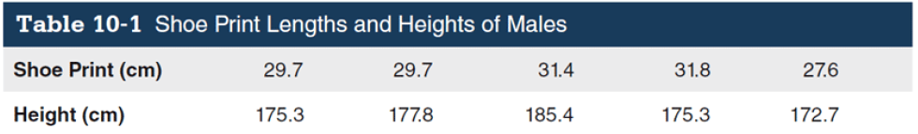
Example
We would like to use the explanatory variable, x, shoe print length, to predict the response variable, y, height.
The data are listed below:

Slide 8
Requirement Check:
1.The data are assumed to be a simple random sample.
2.The scatterplot showed a roughly straight-line pattern.
3.There are no outliers.
The use of technology is recommended for finding the equation of a regression line.

Slide 9

Using StatCrunch, we obtain the following result:
So then, the regression equation can be expressed as:
Y = 125 + 1.73x

Slide 10
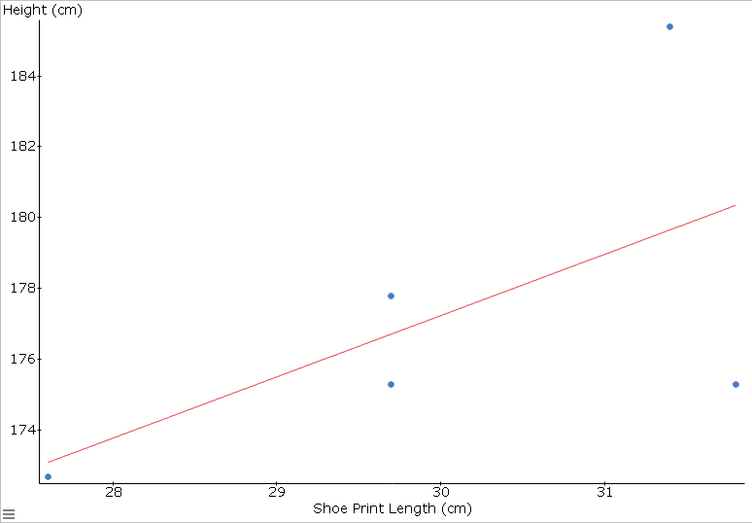
Graph the regression equation on a scatterplot:

Slide 11
Regression equation for predictions
Use the regression equation for predictions ONLY if the graph of the regression line on the scatter plot confirms that the line fits the points reasonably well.
Use the equation for predictions ONLY if the data used for prediction does not go much beyond the scope of the available sample data.
Use the equation for prediction ONLY if 𝑟 indicates that there is a significant linear correlation indicated between the two variables, 𝑥 and 𝑦
Notice: If the regression equation does not appear to be useful for predictions, the best predicted value of a 𝑦 variable is its point estimate [i.e. the sample mean of the 𝑦 variable would be the best predicted value for that variable]

Slide 12
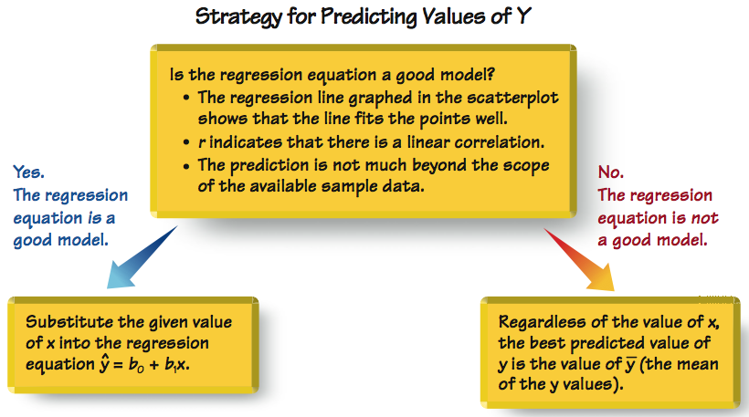

Slide 13
Marginal change
Marginal change – in working with two variables related by a regression equation, the marginal change in a variable is the amount that the variable changes when the other variable changes by exactly one unit
The slope, 𝑏₁, in the regression equation is the marginal change in 𝑦 when 𝑥 changes by one unit

Slide 14

example
For the 40 pairs of shoe print lengths and heights, the regression equation was:
The slope of 3.22 tells us that if we increase shoe print length by 1 cm, the predicted height of a person increases by 3.22 cm.

Slide 15
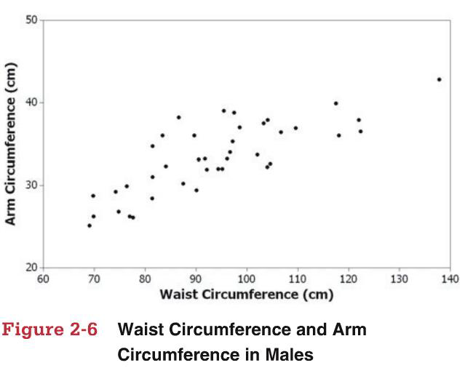
Statistical graphs
Scatter Plot – plot of paired 𝑥,𝑦 quantitative data with a dot representing each pair of points
Helpful in determining whether there is a relationship between two variables

Slide 16
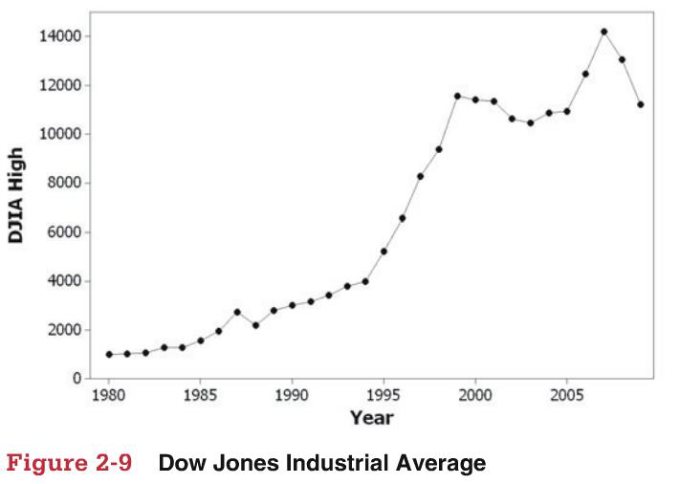
Statistical graphs
Time Series Graph – quantitative data collected over time and plotted accordingly with the horizontal axis representing some measure of time

Slide 17
Background definition / concepts
Outlier – in a scatter plot, an outlier is a point lying far away from the other data points
Influential point – a point that strongly affects the graph of the regression line

Slide 18
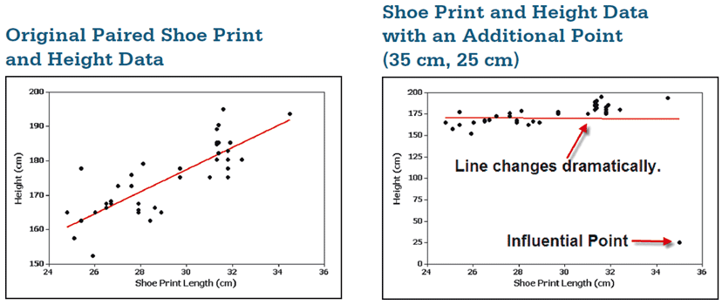
example
For the 40 pairs of shoe prints and heights, observe what happens if we include this additional data point:
x = 35 cm and y = 25 cm

Slide 19
The additional point is an influential point because the graph of the regression line because the graph of the regression line did change considerably.
The additional point is also an outlier because it is far from the other points.

Slide 20
Residual and the least squares property
Residual – for a pair of sample 𝑥 and 𝑦 values, the difference between the observed sample value of 𝑦 (a true value observed) and the y-value that is predicted by using the regression equation 𝑦^ is the residual
𝑅𝑒𝑠𝑖𝑑𝑢𝑎𝑙 = 𝑂𝑏𝑠𝑒𝑟𝑣𝑒𝑑 − 𝑃𝑟𝑒𝑑𝑖𝑐𝑡𝑒𝑑 = 𝑦 − 𝑦^
A residual represents a type of inherent prediction error
The regression equation does not, typically, pass through all the observed data values that we have
The Least Squares Property – a straight line satisfies this property if the sum of the squares of the residuals is the smallest sum possible

Slide 21
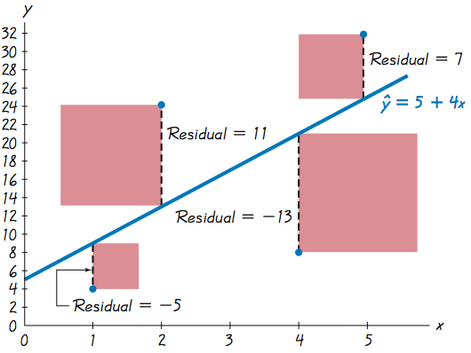
residuals

Slide 22
Logistic Regression

Slide 23
AIMS
When and Why do we Use Logistic Regression?
Binary
Multinomial
Theory Behind Logistic Regression
Assessing the Model
Assessing predictors
Things that can go Wrong
Interpreting Logistic Regression

Slide 24
When and why
To predict an outcome variable that is categorical from one or more categorical or continuous predictor variables.
Used because having a categorical outcome variable violates the assumption of linearity in normal regression.

Slide 25
When and why
No assumptions about the distributions of the predictor variables.
Predictors do not have to be normally distributed
Logistic regression does not make any assumptions of normality, linearity, and homogeneity of variance for the independent variables.
Because it does not impose these requirements, it is preferred to discriminant analysis when the data does not satisfy these assumptions.

Slide 26
Logistic regression is used to analyze relationships between a dichotomous dependent variable and continue or dichotomous independent variables.
Logistic regression combines the independent variables to estimate the probability that a particular event will occur, i.e. a subject will be a member of one of the groups defined by the dichotomous dependent variable.

Slide 27
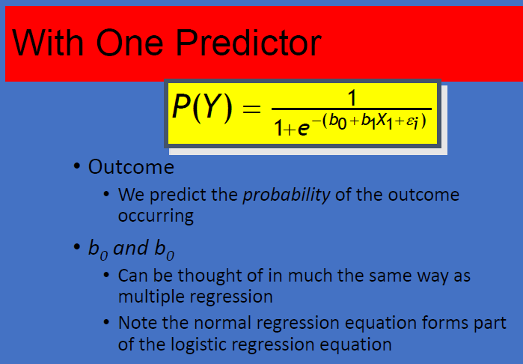

Slide 28
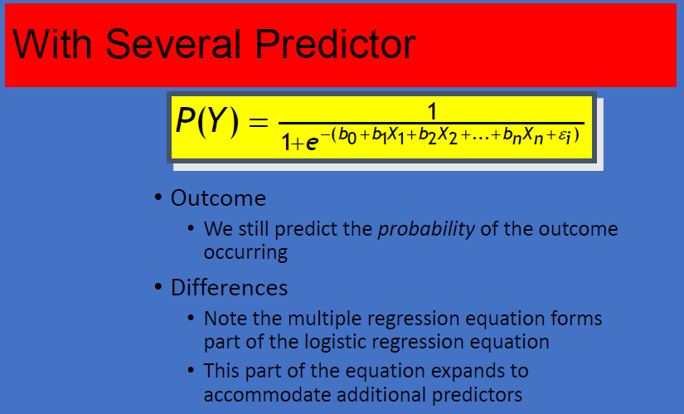

Slide 29
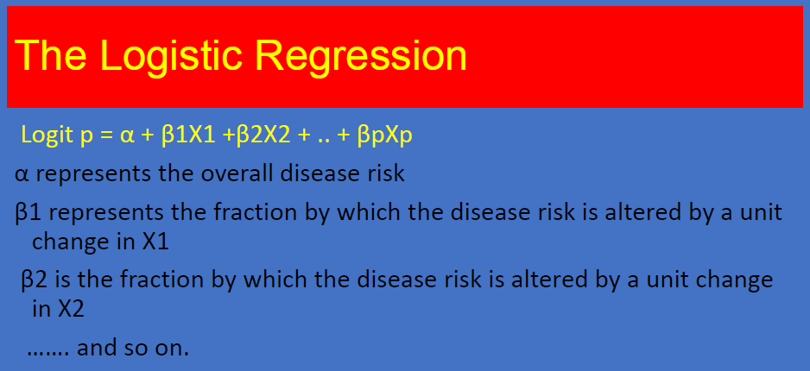

Slide 30
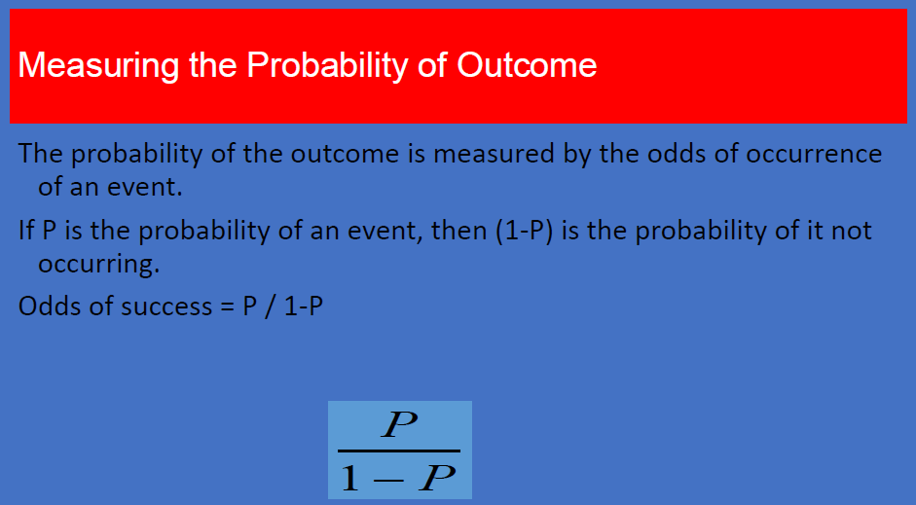

Slide 31
Objectives Of logistic regression
Identify the independent variable that impact in the dependent variable
Establishing classification system based on the logistic model for determining the group membership

Slide 32
Types of logistic regression
BINARY LOGISTIC REGRESSION
It is used when the dependent variable is dichotomous.
MULTINOMIAL LOGISTIC REGRESSION
It is used when the dependent or outcomes variable has more than two categories.

Slide 33
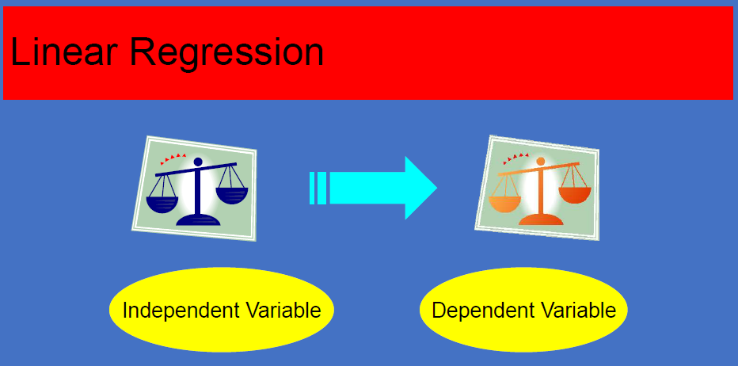

Slide 34
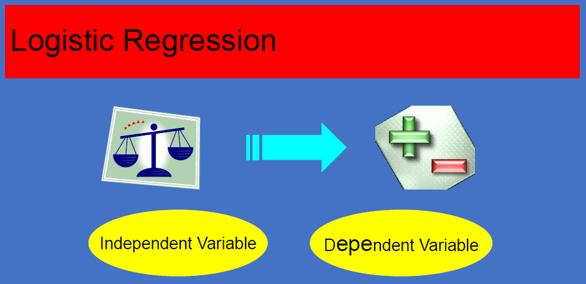

Slide 35
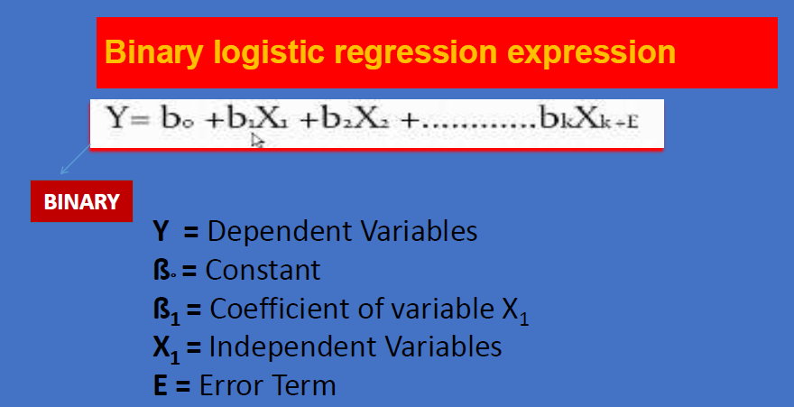

Slide 36
Sample sie
Very small samples have so much sampling errors.
Very large sample size decreases the chances of errors.
Logistic requires larger sample size than multiple regression.

Slide 37
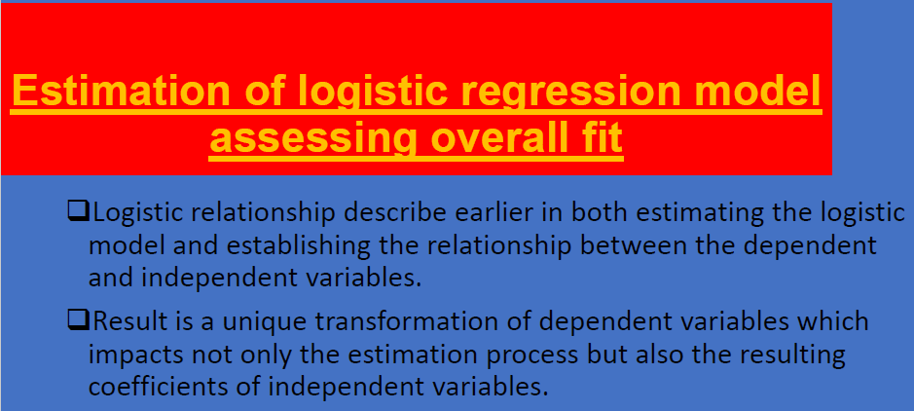

Slide 38
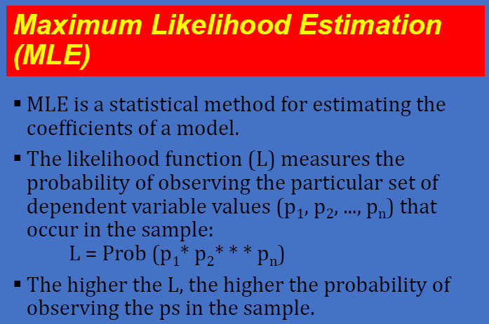

Slide 39
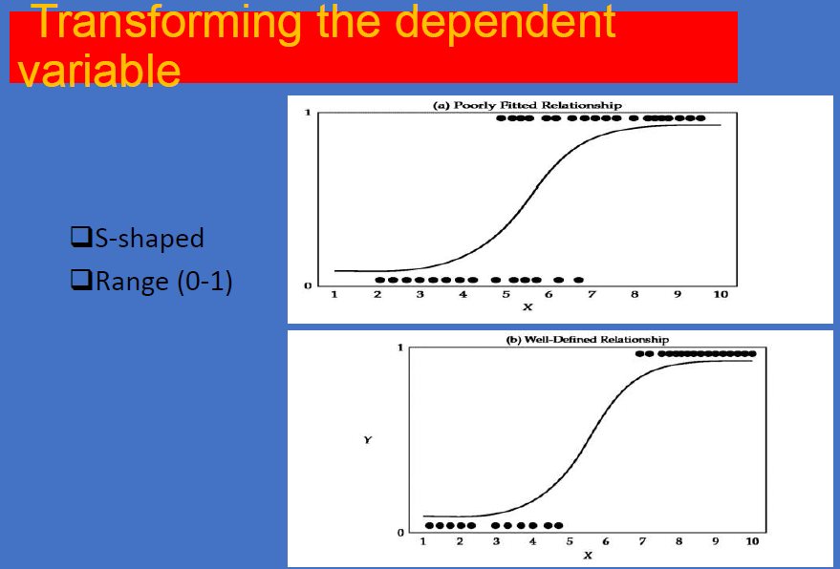

Slide 40
